Slide 1

SOFTWARE ENGINEERING & SDLC
Yerram Sneha

Slide 2
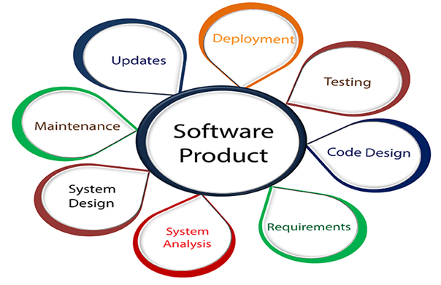
What is Software Engineering?
The term software engineering is the product of two words, software, and engineering.
The software is a collection of integrated programs.
Software subsists of carefully-organized instructions and code written by developers on any of various particular computer languages.
Computer programs and related documentation such as requirements, design models and user manuals.
Engineering is the application of scientific and practical knowledge to invent, design, build, maintain, and improve frameworks, processes, etc.

Slide 3
Software Engineering is an engineering branch related to the evolution of software product using well-defined scientific principles, techniques, and procedures. The result of software engineering is an effective and reliable software product.
Why is Software Engineering required?
Software Engineering is required due to the following reasons:
To manage Large software
For more Scalability
Cost Management
To manage the dynamic nature of software
For better quality Management
Characteristics of a good software engineer
The features that good software engineers should possess are as follows:
Exposure to systematic methods, i.e., familiarity with software engineering principles.
Good technical knowledge of the project range (Domain knowledge).
Good programming abilities.
Good communication skills. These skills comprise of oral, written, and interpersonal skills.
High motivation.
Sound knowledge of fundamentals of computer science.
Intelligence.
Ability to work in a team
Discipline, etc.
Need of Software Engineering
Huge Programming:
Adaptability:
Cost:
Dynamic Nature:
Quality Management:

Slide 4
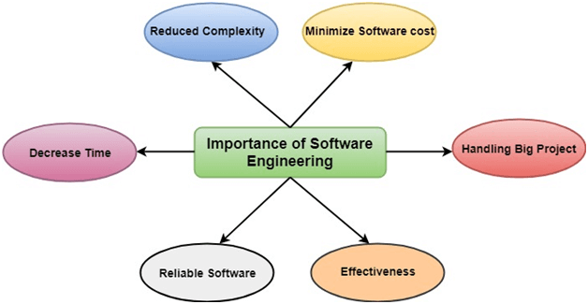

Slide 5
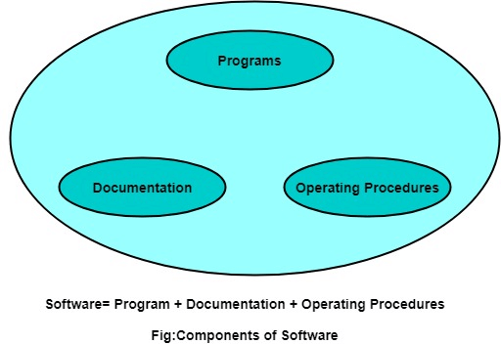
Software Processes
The term software specifies to the set of computer programs, procedures and associated documents (Flowcharts, manuals, etc.) that describe the program and how they are to be used.
A software process is the set of activities and associated outcome that produce a software product. Software engineers mostly carry out these activities. These are four key process activities, which are common to all software processes. These activities are:
Program vs. Software
Software is more than programs. Any program is a subset of software, and it becomes software only if documentation & operating procedures manuals are prepared.
There are three components of the software as shown in fig:
Software specifications: The functionality of the software and constraints on its operation must be defined.
Software development: The software to meet the requirement must be produced.
Software validation: The software must be validated to ensure that it does what the customer wants.
Software evolution: The software must evolve to meet changing client needs.

Slide 6
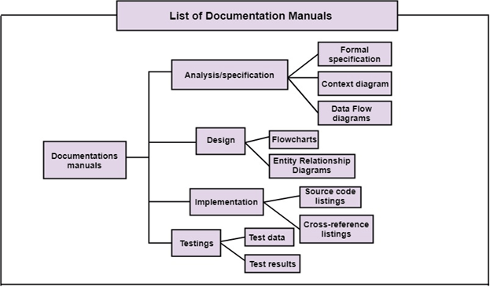
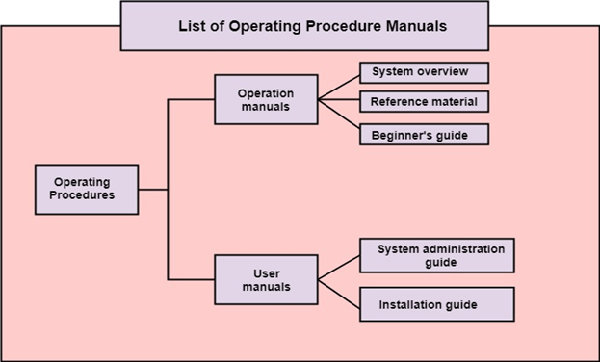
1. Program: Program is a combination of source code & object code.
2. Documentation: Documentation consists of different types of manuals. Examples of documentation manuals are: Data Flow Diagram, Flow Charts, ER diagrams, etc.
3. Operating Procedures: Operating Procedures consist of instructions to set up and use the software system and instructions on how react to the system failure. Example of operating system procedures manuals is: installation guide, Beginner's guide, reference guide, system administration guide, etc.

Slide 7
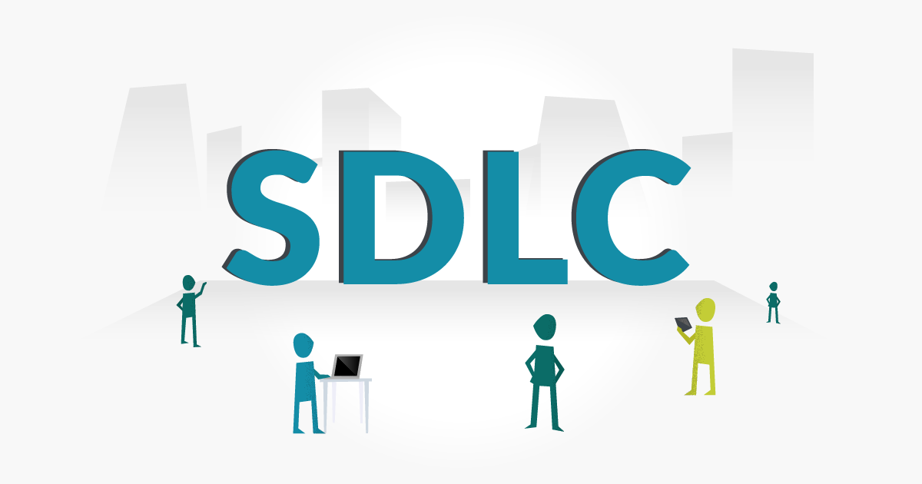
Software Development Life Cycle (SDLC)
A software life cycle model (also termed process model) is a pictorial and diagrammatic representation of the software life cycle. A life cycle model represents all the methods required to make a software product transit through its life cycle stages. It also captures the structure in which these methods are to be undertaken.

Slide 8
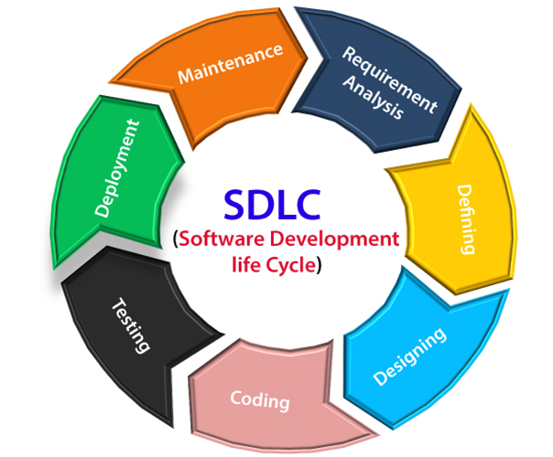
The stages of SDLC are as follows:
Stage1: Planning and requirement analysis
Requirement Analysis is the most important and necessary stage in SDLC.
The senior members of the team perform it with inputs from all the stakeholders and domain experts or SMEs in the industry.
Planning for the quality assurance requirements and identifications of the risks associated with the projects is also done at this stage.
Business analyst and Project organizer set up a meeting with the client to gather all the data like what the customer wants to build, who will be the end user, what is the objective of the product. Before creating a product, a core understanding or knowledge of the product is very necessary.
For Example, A client wants to have an application which concerns money transactions. In this method, the requirement has to be precise like what kind of operations will be done, how it will be done, in which currency it will be done, etc.
Once the required function is done, an analysis is complete with auditing the feasibility of the growth of a product. In case of any ambiguity, a signal is set up for further discussion.
Once the requirement is understood, the SRS (Software Requirement Specification) document is created. The developers should thoroughly follow this document and also should be reviewed by the customer for future reference.

Slide 9
Stage2: Defining Requirements
Once the requirement analysis is done, the next stage is to certainly represent and document the software requirements and get them accepted from the project stakeholders.
This is accomplished through "SRS"- Software Requirement Specification document which contains all the product requirements to be constructed and developed during the project life cycle.
Stage3: Designing the Software
The next phase is about to bring down all the knowledge of requirements, analysis, and design of the software project. This phase is the product of the last two, like inputs from the customer and requirement gathering.
Stage4: Developing the project
In this phase of SDLC, the actual development begins, and the programming is built. The implementation of design begins concerning writing code. Developers have to follow the coding guidelines described by their management and programming tools like compilers, interpreters, debuggers, etc. are used to develop and implement the code.

Slide 10
Stage5: Testing
After the code is generated, it is tested against the requirements to make sure that the products are solving the needs addressed and gathered during the requirements stage.
During this stage, unit testing, integration testing, system testing, acceptance testing are done.
Stage6: Deployment
Once the software is certified, and no bugs or errors are stated, then it is deployed.
Then based on the assessment, the software may be released as it is or with suggested enhancement in the object segment.
After the software is deployed, then its maintenance begins.
Stage7: Maintenance
Once when the client starts using the developed systems, then the real issues come up and requirements to be solved from time to time.
This procedure where the care is taken for the developed product is known as maintenance.

Slide 11
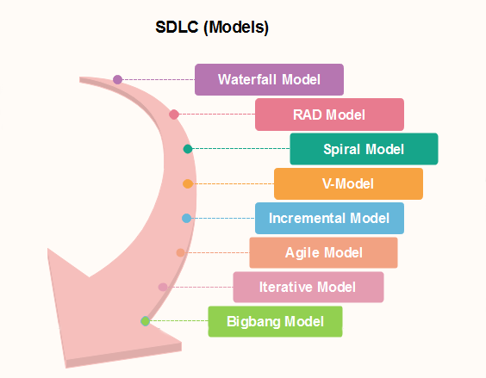
SDLC Models
Software Development life cycle (SDLC) is a spiritual model used in project management that defines the stages include in an information system development project, from an initial feasibility study to the maintenance of the completed application.
There are different software development life cycle models specify and design, which are followed during the software development phase. These models are also called "Software Development Process Models." Each process model follows a series of phase unique to its type to ensure success in the step of software development.
Here, are some important phases of SDLC life cycle:

Slide 12
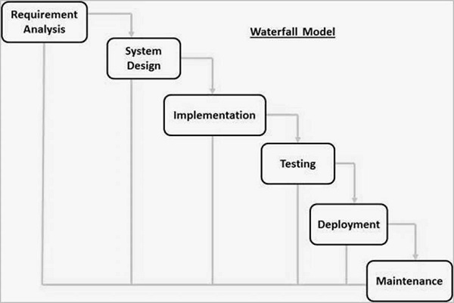
Waterfall Model - Design
The sequential phases in Waterfall model are −
Requirement Gathering and analysis − All possible requirements of the system to be developed are captured in this phase and documented in a requirement specification document.
System Design − The requirement specifications from first phase are studied in this phase and the system design is prepared. This system design helps in specifying hardware and system requirements and helps in defining the overall system architecture.
Implementation − With inputs from the system design, the system is first developed in small programs called units, which are integrated in the next phase. Each unit is developed and tested for its functionality, which is referred to as Unit Testing.
Integration and Testing − All the units developed in the implementation phase are integrated into a system after testing of each unit. Post integration the entire system is tested for any faults and failures.
Deployment of system − Once the functional and non-functional testing is done; the product is deployed in the customer environment or released into the market.
Maintenance − There are some issues which come up in the client environment. To fix those issues, patches are released. Also to enhance the product some better versions are released. Maintenance is done to deliver these changes in the customer environment.
Waterfall Model - Application
Every software developed is different and requires a suitable SDLC approach to be followed based on the internal and external factors. Some situations where the use of Waterfall model is most appropriate are −
Requirements are very well documented, clear and fixed.
Product definition is stable.
Technology is understood and is not dynamic.
There are no ambiguous requirements.
Ample resources with required expertise are available to support the product.
The project is short.

Slide 13
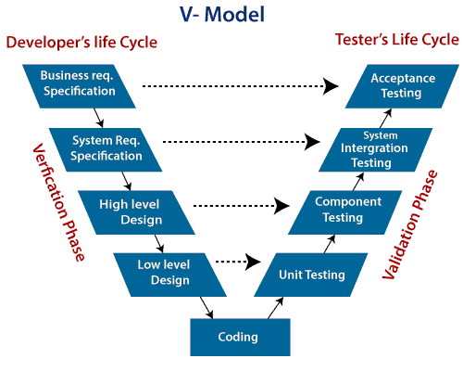
V-Model
V-Model also referred to as the Verification and Validation Model. In this, each phase of SDLC must complete before the next phase starts. It follows a sequential design process same as the waterfall model. Testing of the device is planned in parallel with a corresponding stage of development.
Verification: It involves a static analysis method (review) done without executing code. It is the process of evaluation of the product development process to find whether specified requirements meet.
Validation: It involves dynamic analysis method (functional, non-functional), testing is done by executing code. Validation is the process to classify the software after the completion of the development process to determine whether the software meets the customer expectations and requirements.
So V-Model contains Verification phases on one side of the Validation phases on the other side. Verification and Validation process is joined by coding phase in V-shape. Thus it is known as V-Model.

Slide 14
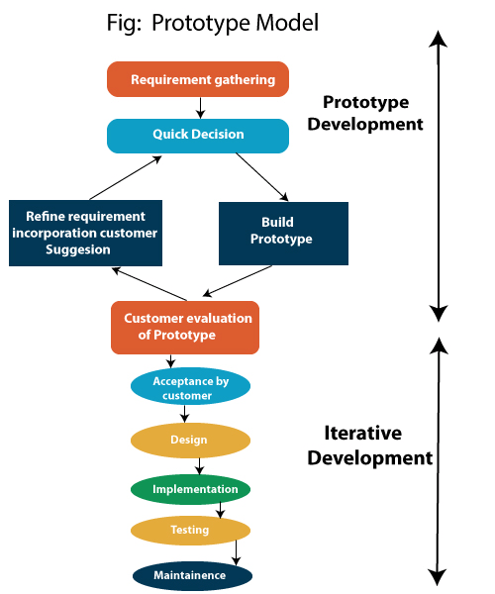
Prototype Model
The prototype model requires that before carrying out the development of actual software, a working prototype of the system should be built. A prototype is a toy implementation of the system. A prototype usually turns out to be a very crude version of the actual system, possible exhibiting limited functional capabilities, low reliability, and inefficient performance as compared to actual software. In many instances, the client only has a general view of what is expected from the software product. In such a scenario where there is an absence of detailed information regarding the input to the system, the processing needs, and the output requirement, the prototyping model may be employed.
Steps of Prototype Model
Requirement Gathering and Analyst
Quick Decision
Build a Prototype
Assessment or User Evaluation
Prototype Refinement
Engineer Product

Slide 15
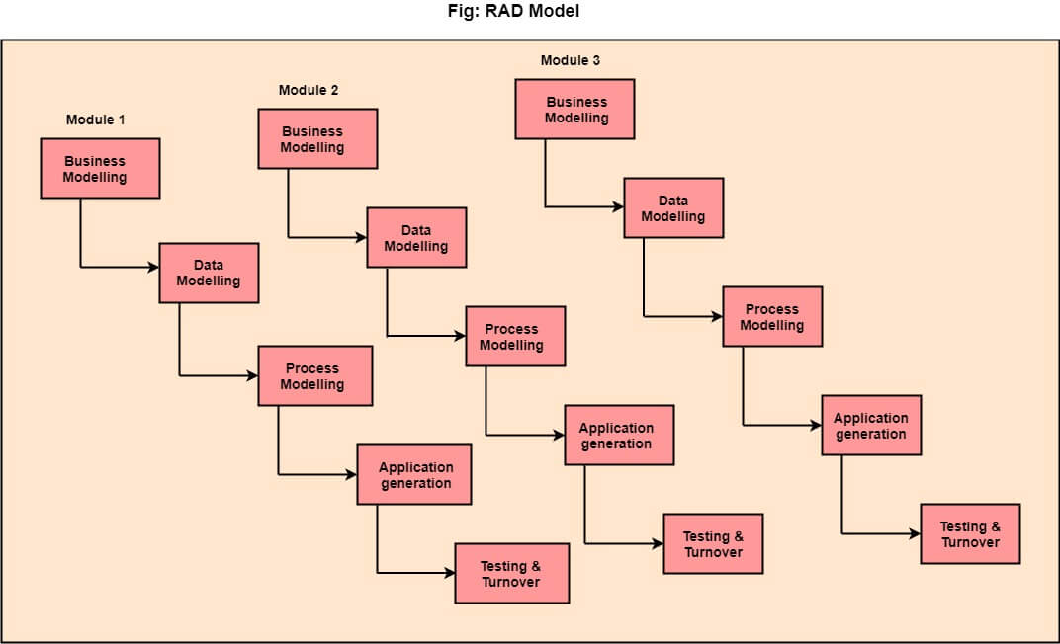
RAD (Rapid Application Development) Model
RAD is a linear sequential software development process model that emphasizes a concise development cycle using an element based construction approach. If the requirements are well understood and described, and the project scope is a constraint, the RAD process enables a development team to create a fully functional system within a concise time period.
RAD (Rapid Application Development) is a concept that products can be developed faster and of higher quality through:
Gathering requirements using workshops or focus groups
Prototyping and early, reiterative user testing of designs
The re-use of software components
A rigidly paced schedule that refers design improvements to the next product version
Less formality in reviews and other team communication

Slide 16
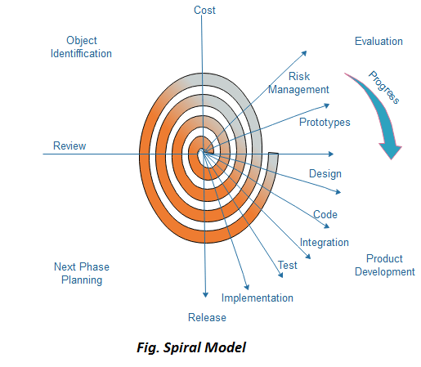
Spiral Model
The spiral model, initially proposed by Boehm, is an evolutionary software process model that couples the iterative feature of prototyping with the controlled and systematic aspects of the linear sequential model. It implements the potential for rapid development of new versions of the software. Using the spiral model, the software is developed in a series of incremental releases. During the early iterations, the additional release may be a paper model or prototype. During later iterations, more and more complete versions of the engineered system are produced.
Each cycle in the spiral is divided into four parts:
Objective setting: Each cycle in the spiral starts with the identification of purpose for that cycle, the various alternatives that are possible for achieving the targets, and the constraints that exists.
Risk Assessment and reduction: The next phase in the cycle is to calculate these various alternatives based on the goals and constraints. The focus of evaluation in this stage is located on the risk perception for the project.
Development and validation: The next phase is to develop strategies that resolve uncertainties and risks. This process may include activities such as benchmarking, simulation, and prototyping.
Planning: Finally, the next step is planned. The project is reviewed, and a choice made whether to continue with a further period of the spiral. If it is determined to keep, plans are drawn up for the next step of the project.

Slide 17
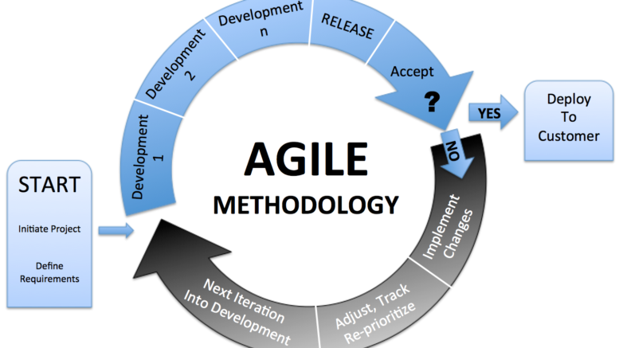
What is Agile Methodology?
Agile Methodology meaning a practice that promotes continuous iteration of development and testing throughout the software development lifecycle of the project. In the Agile model in software testing, both development and testing activities are concurrent, unlike the Waterfall model.
What is Agile Software Development?
The Agile software development methodology is one of the simplest and effective processes to turn a vision for a business need into software solutions. Agile is a term used to describe software development approaches that employ continual planning, learning, improvement, team collaboration, evolutionary development, and early delivery. It encourages flexible responses to change.

Slide 18
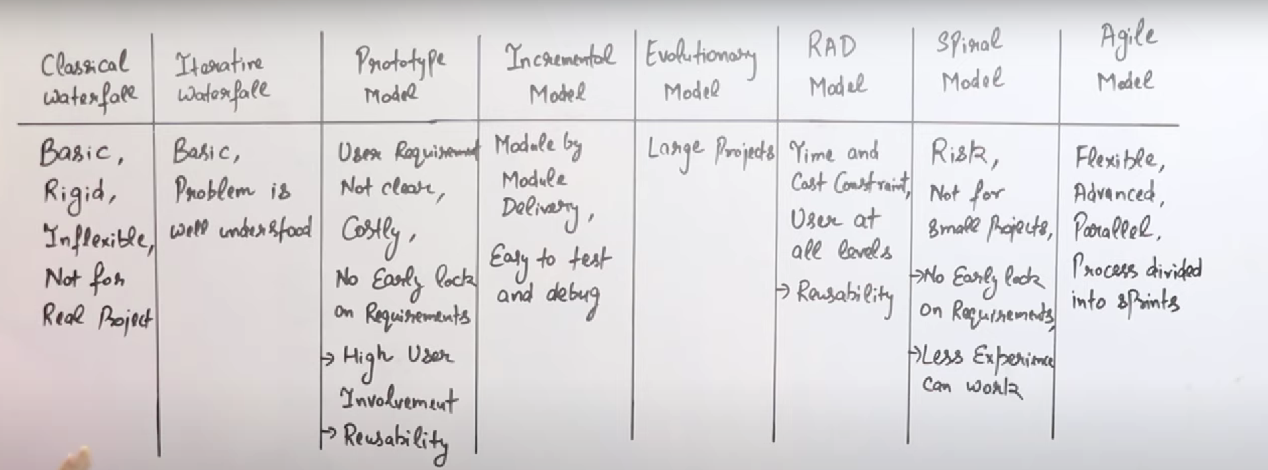

Slide 19
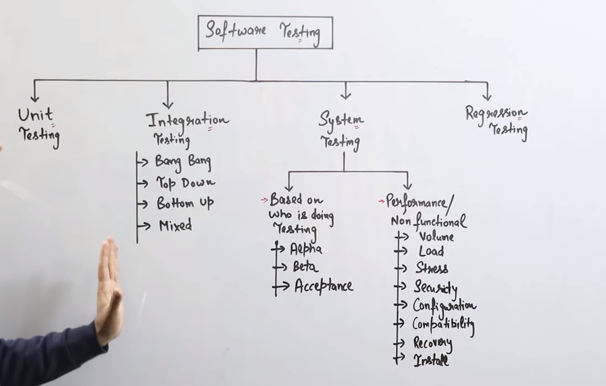
Unit Testing : Is Development Level Testing In The Development Testing Will Be Done
Integration Testing : Small Small Modules Are Combined/ Implemented Then This Testing Will Happen For Checking That They Working Fine Together
System Testing :
Is Actual Testing Phase In Which Rigorous Testing Will Be Done
Regression Testing :
This Is Done In Maintenance

Slide 20
